Slide 1
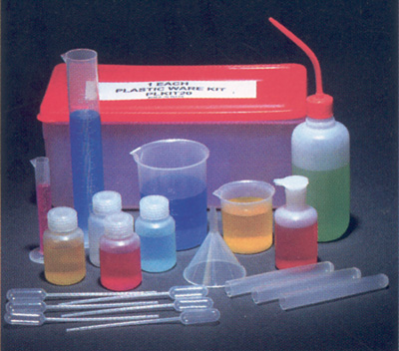
Biological and Laboratory Supplies & Equipment
Statewide Contract Webinar
Notes:
Good afternoon everyone. My name is Carol Kennedy-Sims. I am a Category Manager in the Strategic Sourcing Division of State Purchasing. Thank you for joining today’s webinar for the Statewide Contract for Biological and Laboratory Supplies & Equipment. Please note that all participants will be muted during the presentation. During the question and answer period, you will please submit your questions via the questions panel. We will do our best to respond to all questions. However, if we are unable to field them all, we will post responses to the remaining questions on the DOAS website. Additionally, this webinar is being recorded and will be posted, in its entirety, on the DOAS website, for your future reference.

Slide 2
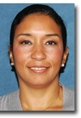
Your Presenter
Title: Category Manager
Experience: 16+ years of Procurement/Contracting Experience
Contact Information:
carol.kennedy-sims@doas.ga.gov
404-656-4314
Carol Kennedy-Sims

Slide 3

Purpose of this Webinar
The purpose of this webinar is to:
Explain the purpose of the Statewide Contract
Review the benefits of the Statewide Contract
Highlight specific details related to the Statewide Contract
List the steps you follow to find the Statewide Contract on the SPD website
Review the suppliers selected to provide products and service under this statewide contract
Discuss FAQs related to the Statewide Contract
Describe the procedures for obtaining more information about the Statewide Contract.
Statewide Contracts
Notes:
What is the purpose of this informational webinar? This session is designed to………,

Slide 4

Purpose
The purpose of the new Statewide Contract for Biological and Laboratory Supplies & Equipment is to:
Provide a broad product range of Biological and Laboratory Supplies & Equipment to State Agencies, Universities/Colleges and Municipal Users at the overall most competitive price & terms.
Statewide Contracts
Notes:
This contract can be best described as a “Preferred Convenience” contract. Your DOAS procurement team has worked extremely hard to conduct a solid competitive solicitation for this category which has resulted in very deep discounts on a market basket of approximately 900 “Hot List” Items used most frequently throughout the State, as well as very deep discounts off the catalog list price for thousands of additional Non-Core Items. If you consider the full Core market-basket, you will see the awesome leverage of State spend which served as the solid foundation for our negotiating such favorable pricing – pricing which would be very difficult to compete with independent of this contract.

Slide 5
Statewide Contract Details
About the Statewide Contract
What is the Contract Number?
99999-SPD-SPD0000088-001 thru 009
(9 Suppliers on this SWC)
Is it a Renewal?
No
Does it Replace an Existing Contract?
Yes (SWC30747- Biological Supplies, SWC10525-Microscopes, SWC10479- Culture Media)
What is the Contract Term?
08/15/2013 – 07/31/2015
Implementation “Go-Live Date”
August 15, 2013
Does it Allow the Use of the P-Card?
Yes
Who is the Person to Contact with Questions:
Carol Kennedy-Sims
Carol.kennedy-sims@doas.ga.gov
404-656-4314
Notes:
[Title of the course]
23-Mar-15
Copyright © 2004-2005 NameOfTheOrganization. All rights reserved.
5
Again, resulting from a very competitive bidding environment, DOAS awarded statewide contracts to 9 suppliers for Biological & Laboratory Equipment and Supplies. It is very important to note that each of these suppliers are contracted to provide only the AWARDED CATEGORY/CATEGORIES, under this contract (categories on next slide).
This contract went “Live” on 8-15-2013.

Slide 6
Biological and Laboratory Equipment & Supplies – 12 Categories
Category # | Category Description
1 | Biological Supplies (dishes, trays, plates, kits, plasma, etc.)
2 | Chemicals (acid, methanol, acetone, sulfate, etc.)
3 | Consumables (pipet, cartridges, petri dish, tubes, etc.)
4 | Diagnostics (oxidase, tablets, stains, reagents, etc.)
5 | Lab Glassware (glass kits, beakers, funnel, vials, etc.)
6 | Lab Instruments (spectrafuge, thermometer, mixer, etc.)
7 | Lab Equipment (hot plate, refrigerator/freezer, oven, etc.)
8 | Lab Furniture (storage cabinet, utility cart, casters, etc.)
9 | Safety Equipment & Clothing (gloves, lab coats, etc.)
10 | Science and Education (pellets, models, skeletons, etc.)
11 | Culture Media (broth, agar, etc.)
12 | Microscopes
Notes:
Previously there were three contracts (Biological Supplies, Culture Media & Microscopes). Now all items from all three previous contracts can be found within this one contract. Categories 1-9 Encompass “hot list” items, as well as various percentages off of non-core catalog items. Categories 10-12 contain various percentages off catalog items.

Slide 7
Awarded Vendors (Per Category) for SWC 99999-SPD-SPD0000088
Contract # | Vendor Name | Category Awarded
99999-SPD-SPD0000088-001 | Leica Microsystems | Category 12
99999-SPD-SPD0000088-002 | MedSupply Partners | Categories 1-7, 9-12
99999-SPD-SPD0000088-003 | Nikon Instruments | Category 12
99999-SPD-SPD0000088-005 | Vashaw Scientific | Category 12
99999-SPD-SPD0000088-006 | Capital Microscopes | Category 12
99999-SPD-SPD0000088-007 | Carolina Biological | Categories 10, 12
99999-SPD-SPD0000088-008 | Fisher Scientific | Categories 1-12
99999-SPD-SPD0000088-009 | VWR | Categories 1-12
99999-SPD-SPD0000088-009 | Ward’s Science (a division of VWR) | Categories 10-12

Slide 8





About the suppliers……
FAMILIAR SUPPLIERS
- Capital Microscope Svcs. is a local, full-service distributor of microscopes located in Marietta, GA. They are authorized distributors of Swift, Motic, Meiji Techno, Parco, National, Accuscope, LW, Ken a Vision.
- Carolina Biological Supply Co. is a distributor and manufacturer of educational specimens & materials for educators and health and science professionals located in Burlington, NC.
- Fisher Scientific is a full-service manufacturer and distributor of lab equipment, chemicals, supplies & services for research, safety , healthcare & science education located in Pittsburg, PA.
- Nikon Instruments is a full-service manufacturer and seller of optical instruments (microscopes) located in Melville, NY.
- Vashaw Scientific is a local, full-service distributor of traditional & custom optical and imaging solutions (microscopes) with a corporate sales & service office located in Norcross, GA. They are authorized distributors of Leica, Mitutoyo, Navitar, Labomed, Eppendorf, Narishige.
- VWR International is a full-service manufacturer and distributor of chemicals, lab furniture & equipment, scientific instruments, apparel and consumables with a local distribution & sales office in Suwanee, GA.

Slide 9



About the suppliers (continued)……
NEW SUPPLIERS
- Leica Microsystems is a full-service manufacturer of specialized microscopes and scientific instruments with a sales and service center located in Buffalo Grove, IL.
- MedSupply Partners is a local, full-service distributor of lab equipment, consumables, scientific products and chemicals with a distribution and sales center located in Atlanta, GA.
- Ward’s Science (a division of VWR) is a distributor of innovative science education supplies & services for learning environments with a distribution and sales center located in Rochester, NY. Ward’s products include, but are not limited to materials in the following categories; AP Science, Biology, Chemistry and Chemicals, Custom Kits, Environmental & Forensic Science, Geology, Lab Equipment, etc.

Slide 10
Key Benefits
The Biological and Lab Supplies & Equipment Contract provides the following benefits:
Deep Discounts on approximately 900 “Hot List” (Core) and thousands of Catalog Items
(Discount Ranges from 15%-70% depending on category)
No Shipping Charges for orders over $50.00
Accepts P-Card
Accepts Orders from Team GA Marketplace, Phone and Fax Orders
Efficient returns process (within 7 days)
Dedicated Account Management and Customer Service Team
Access to the following:
- Numerous “green” based product offerings
- Various Vendor Managed Inventory (VMI) Programs
- Consignment stock programs
Notes:
While price was a very important consideration during the bidding event, it was not the only factor considered. Some of the other resulting Key Benefits of this contract include:

Slide 11
TEAM GEORGIA MARKETPLACE ORDERING PROCESS
Notes:
I would like to now introduce Mr. Ed Macey and Mr. Marcus Britton, of DOAS, who will provide you an overview of how to order office supply items, for those who are currently on Team Georgia Marketplace. Ed/Marcus

Slide 12
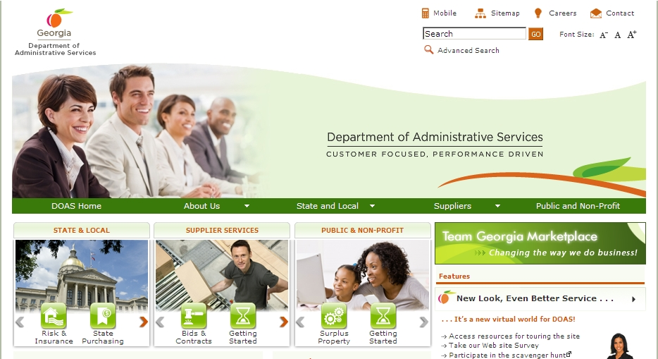
Where to Find this Statewide Contract
State Purchasing Division – Statewide Contracts
1. Visit the DOAS website at www.doas.ga.gov.

Slide 13
Where to Find this Statewide Contract
State Purchasing Division – Statewide Contracts
1. Visit the DOAS website at www.doas.ga.gov.

Slide 14
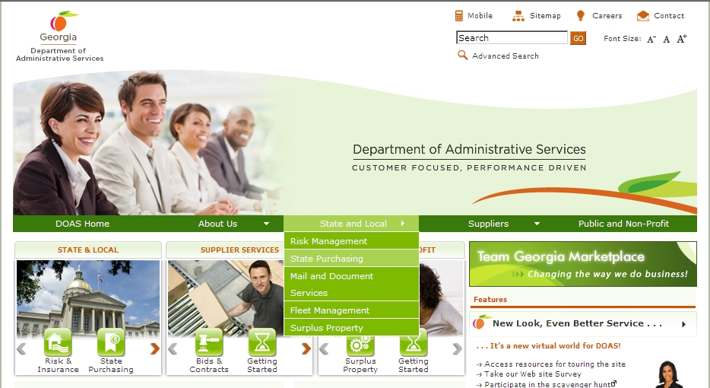
Where to Find this Statewide Contract
State Purchasing Division – Statewide Contracts
Hover over the State and Local section of the screen
2. Hover over the State and Local section of the screen.
3. Click on State Purchasing.

Slide 15

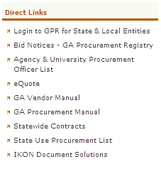
Where to Find this Statewide Contract
State Purchasing Division – Statewide Contracts
Click on Statewide Contracts
4. In the Direct Links section, click on Statewide Contracts.

Slide 16
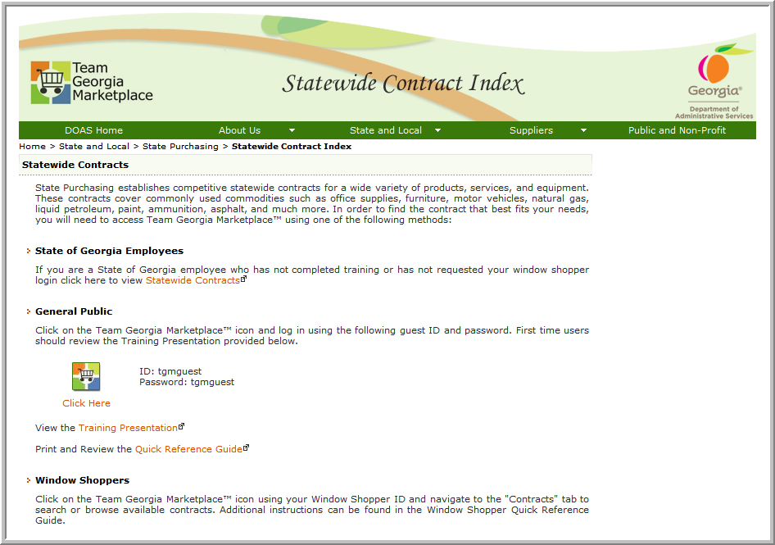
SWC Index for Public
5. To access contract information, click on the Team Georgia Marketplace™ icon to access the Login screen. This User Name and Password is generic and only provides access to contract information.
Use tgmguest
as the User Name and the Password

Slide 17
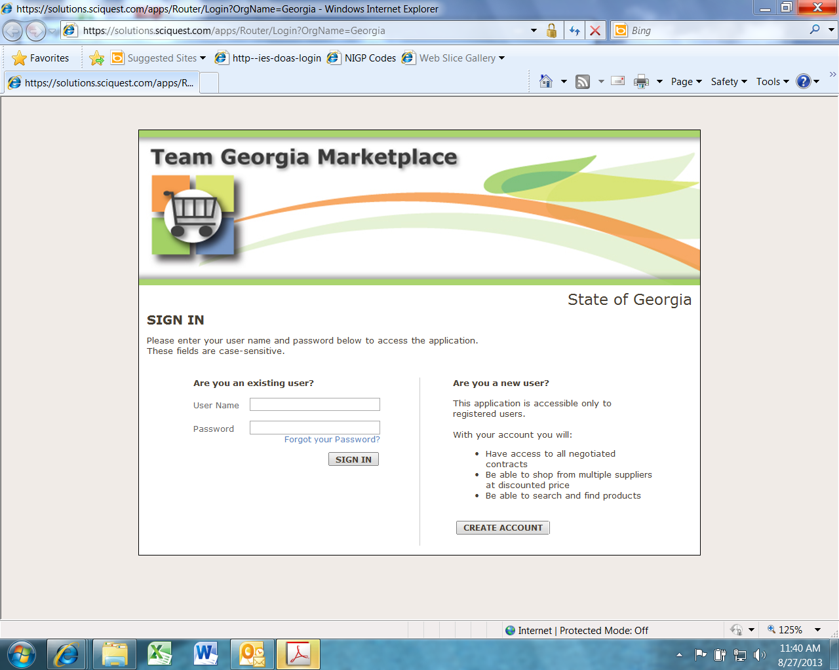
Statewide Contracts Index
6. When the Login screen displays, use tgmguest as the User Name and the Password. This generic ID and Password allows access to contract information only.
Use tgmguest
as the User Name and the Password

Slide 18
SWC Index for Window Shoppers
You can also click on the Team Georgia Marketplace™ icon to access the same Login screen, but enter your personal Window Shopper User Name and Password. This allows you to access the Statewide Contract Index as well as to shop for items available from the Statewide Contracts.

Slide 19
SWC for Window Shoppers
If you are a Window Shopper user, you can access the Statewide Contract Index by entering your personal User Name and the Password once the Login screen displays. Then, click on the Contracts tab.
Use your Window Shopper User Name and Password

Slide 20
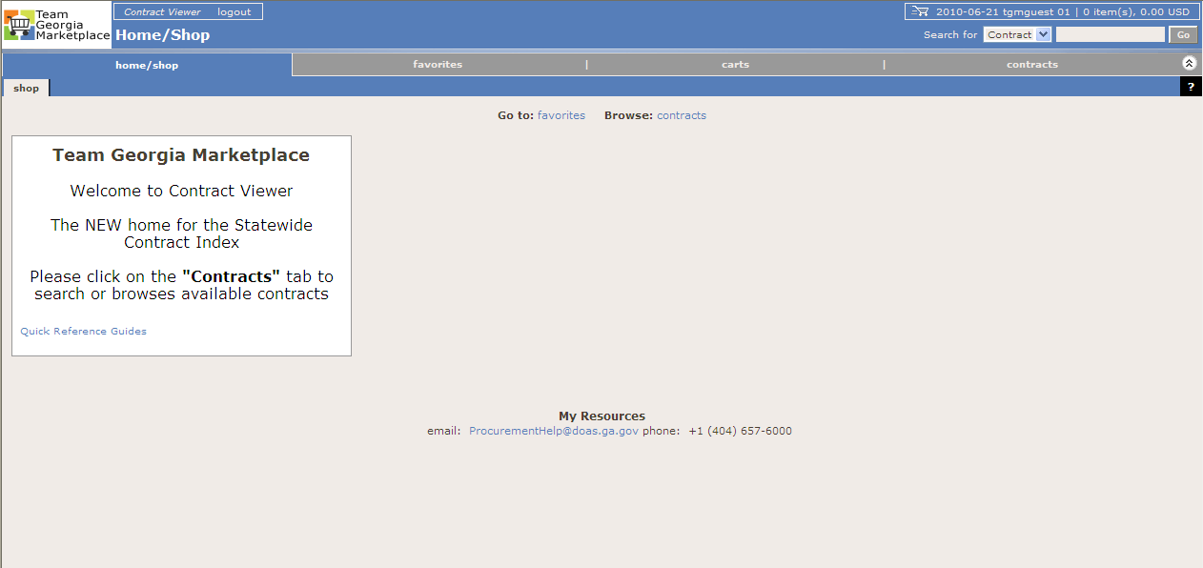
Team Georgia Marketplace Contracts
Once you access the system using the generic or your personal User Name and Password, click on the Contracts tab to access the Statewide Contracts.
Click on the Contracts tab

Slide 21
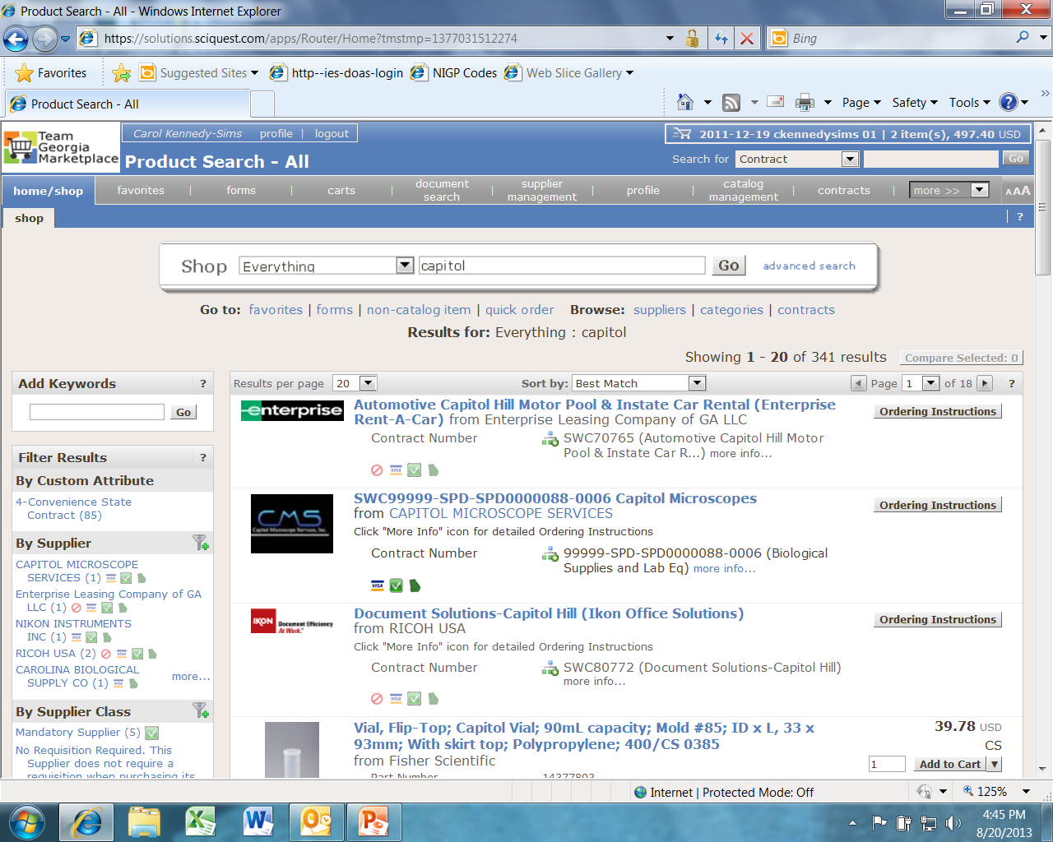
TGM – Supplier Catalogs Not Available Hosted or Punchout
Click for special ordering instructions.
Suppliers with “Ordering Instructions” only in TGM:
Capital Microscope Services
Leica Microsystems
Nikon Instruments
Vashaw Scientific
Ward’s Science
Notes:
The suppliers above do not have hosted or punch-out catalogs in TGM. The ordering instructions for each supplier can be found by clicking the “ordering instructions” link in their respective contract placeholders.

Slide 22
How to use this contract
State Purchasing Division – Statewide Contracts
For all line items, process your P. O. through Team GA Marketplace (TGM). Each supplier has their own hosted and/or punch-out catalog in TGM with the exception of five (5) suppliers (Leica, Capital, Vashaw, Ward’s Science and Nikon). The suppliers have “ordering instructions” listed in TGM.
The Supplier catalogs, which offer a fixed percent discount off the list price, have been made available through Team Georgia Marketplace for purchase (with the exception of the 5 suppliers above).

Slide 23
For More Information
To Contact Suppliers on this Statewide Contract:
Vendor Contact Information:
Leica Microsystems – Cindy Manley, cindy.manley@leica-microsystems.com
800-248-0123 x 7217
MedSupply Partners – Lance Walman, lwalman@medsupply.com
877-633-7779
Nikon Instruments – Samantha Poretto, sporetto@nikon.net
800-526-4566
Ward’s Science – Patti Luciano, patti.luciano@vwr.com
800-962-2660
Vashaw Scientific – Jane Sanderson, jsanderson@vashaw.com
800-241-5939
Carolina Biological – Elizabeth Stanfield, quotations@carolina.com
800-334-5551 x6294
Capital Microscopes – Don Munns, don@microscopesandmore.com
770-422-3314
Fisher Scientific – Kris Schoolfield, kris.schoolfield@thermofisher.com
800-955-1333 x121-3654
VWR – Lewis McMillan, lewis_mcmillan@vwr.com
678-288-3150

Slide 24
For More Information
If you have questions about this Statewide Contract:
Submit Questions to:
Email Address:
carol.kennedy-sims@doas.ga.gov
Person to Contact:
Carol Kennedy-Sims, CPPB, GCPA
Phone Number:
404-656-4314

Slide 25
Questions?
?

